Slide 1
Topic 7: Linear Regression
STOR 155: Introduction to Data Models and Inference
Dr. Teressa Bergland
Fall 2025

Slide 2
Announcements
Course PSAs:
Homework 6 due TODAY, Thursday 2/5 on WebAssign
Homework 7 due Tuesday 2/10
Midterm Exam 1 on Thursday, February 12
100 points
70-80% multiple choice or similar short-form (true/false, matching, etc)
20-30% open-ended problems, will require showing work/justification
Calculator? YES! TI-84 or comparable is OK
Please do not bring a calculator that can access the internet
Formula sheet? YES! Handwritten, single-sided, 8.5x11 or smaller
Please put your name on your sheet – it will be collected with the exam

Slide 3
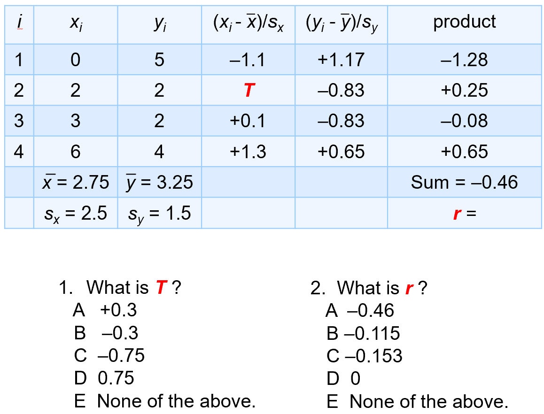
Practice Question #1

Slide 4
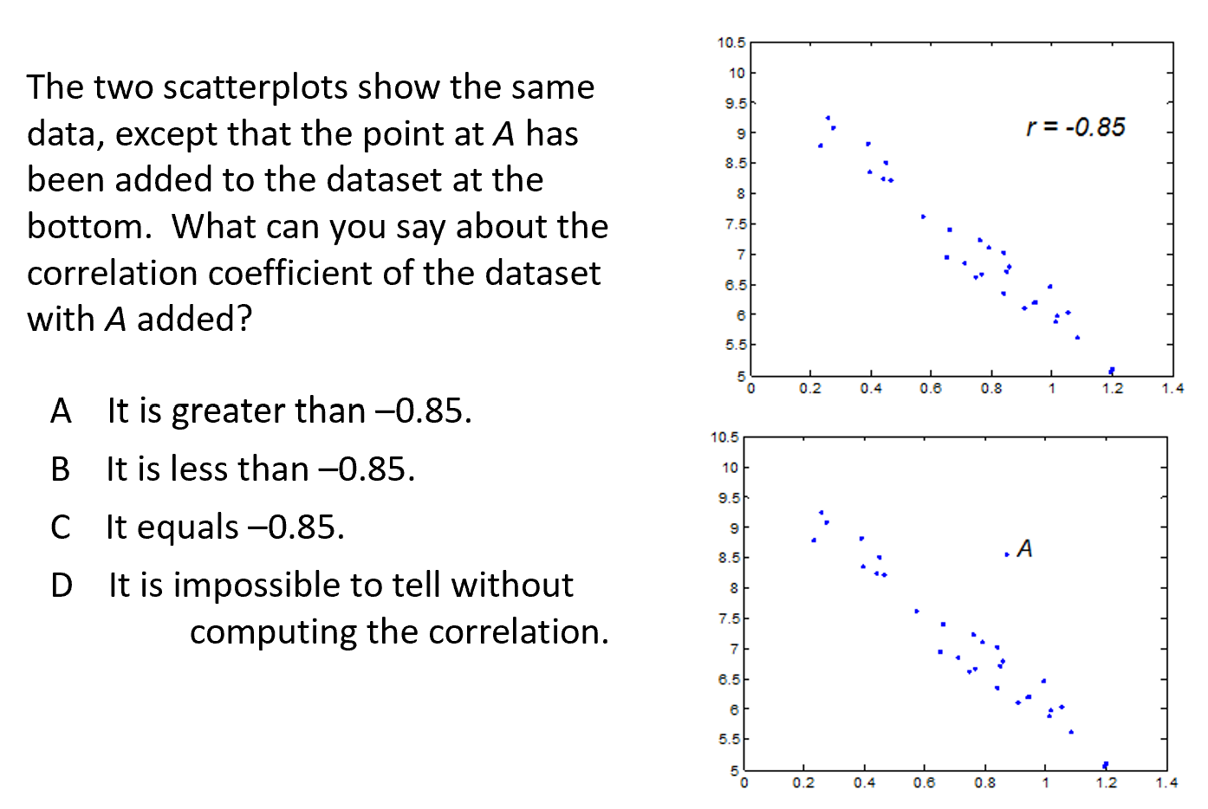
Practice Question #2

Slide 5
Intro to Linear Regression
A regression line describes…
Unlike with correlation, it matters…
Standard equation of a line

Slide 6
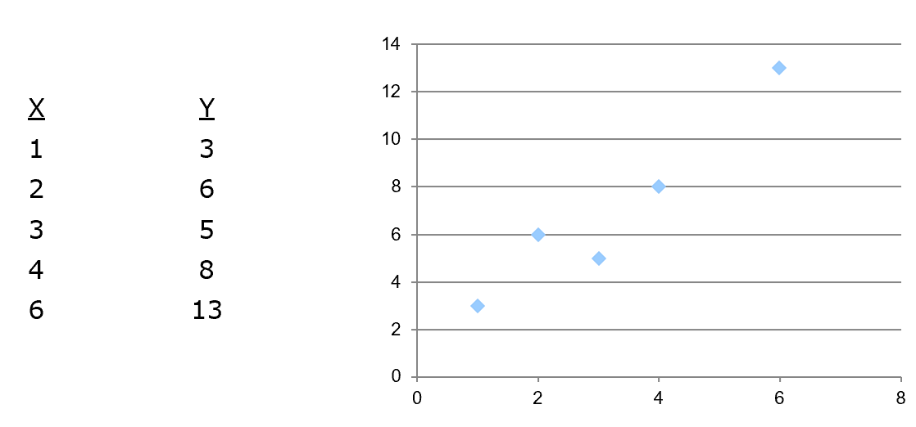
Small Example

Slide 7
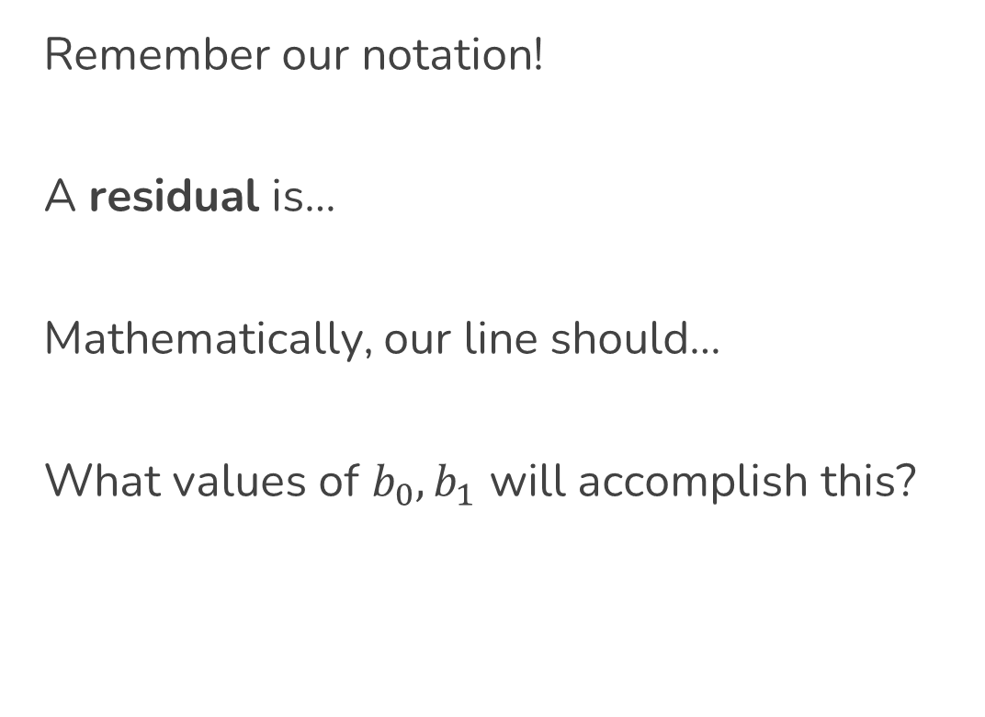
Residuals and Regression Lines
Remember our notation!
A residual is…
Mathematically, our line should…
What values of $b_{0},b_{1}$ will accomplish this?

Slide 8
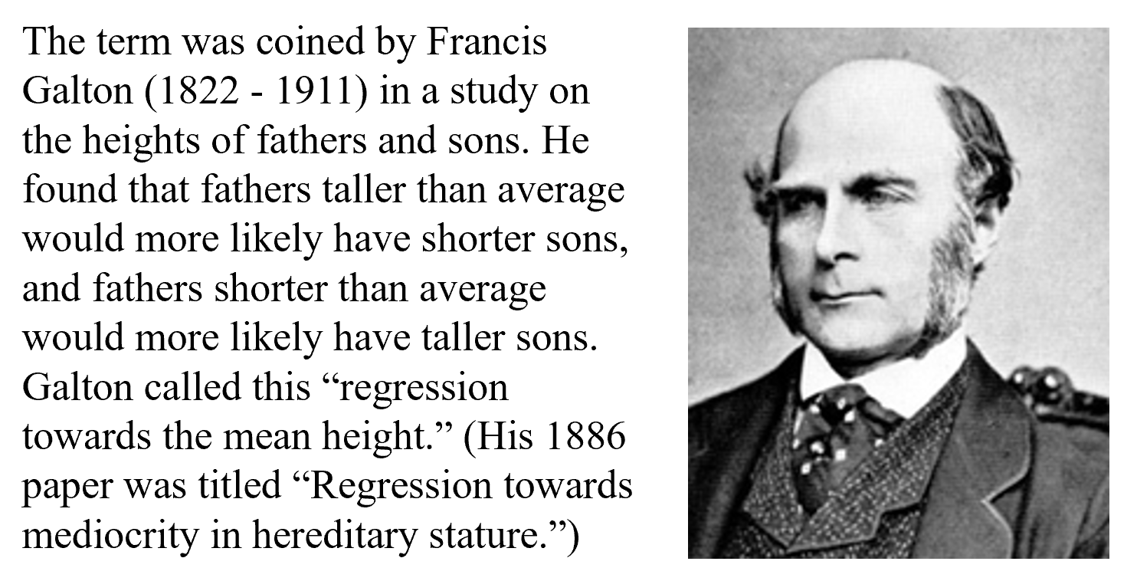
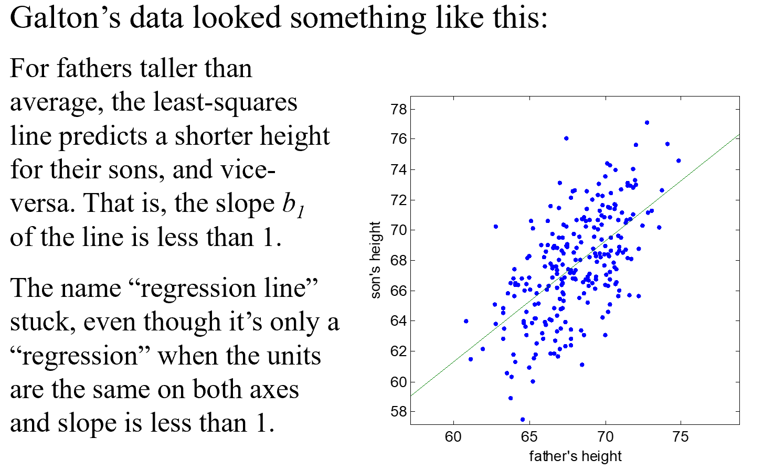
Math History Trivia: “Regression”
Notes:
Skipping this for the sake of time – if you’re interested, you can read the stuff in the notes.

Slide 9
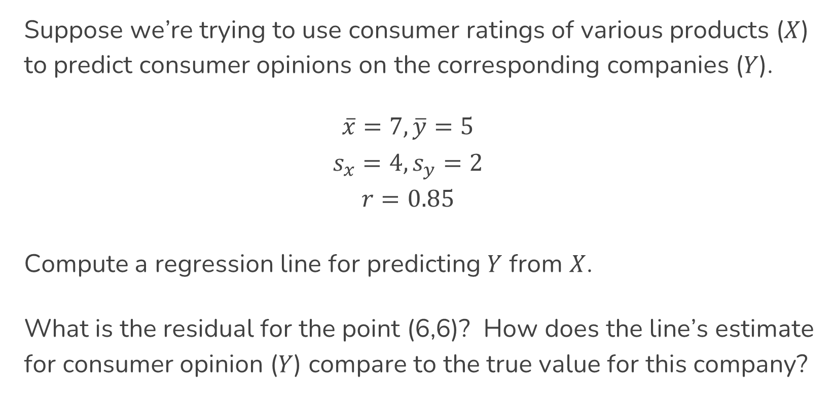
Let’s Practice! Constructing and Using Lines
Suppose we’re trying to use consumer ratings of various products ($X$) to predict consumer opinions on the corresponding companies ($Y$).
$$\overline{x}=7, \overline{y}=5$$
$$s_{x}=4, s_{y}=2$$
$$r=0.85$$
Compute a regression line for predicting $Y$ from $X$.
What is the residual for the point (6,6)? How does the line’s estimate for consumer opinion ($Y$) compare to the true value for this company?

Slide 10
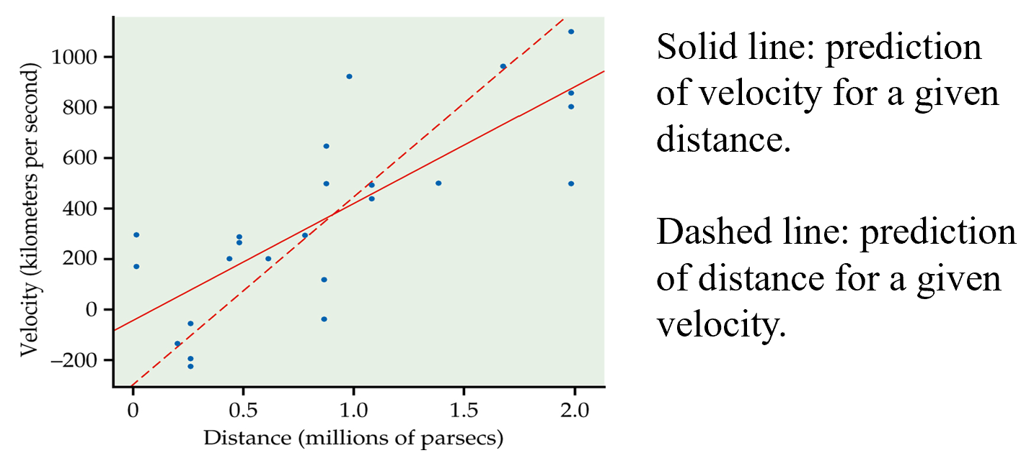

Switching $X$ and $Y$
Will switching the explanatory and response variables change the regression line?

Slide 11
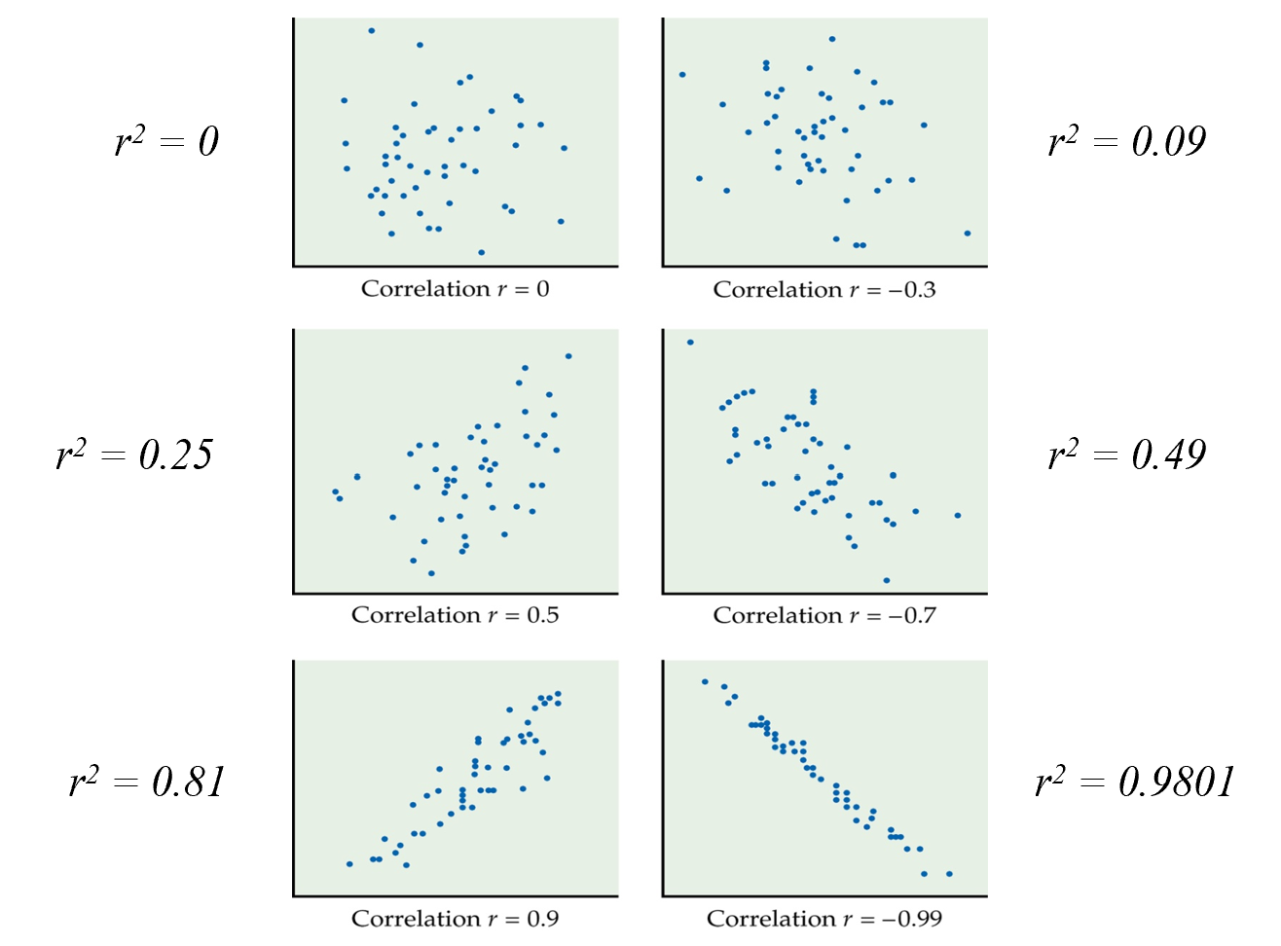
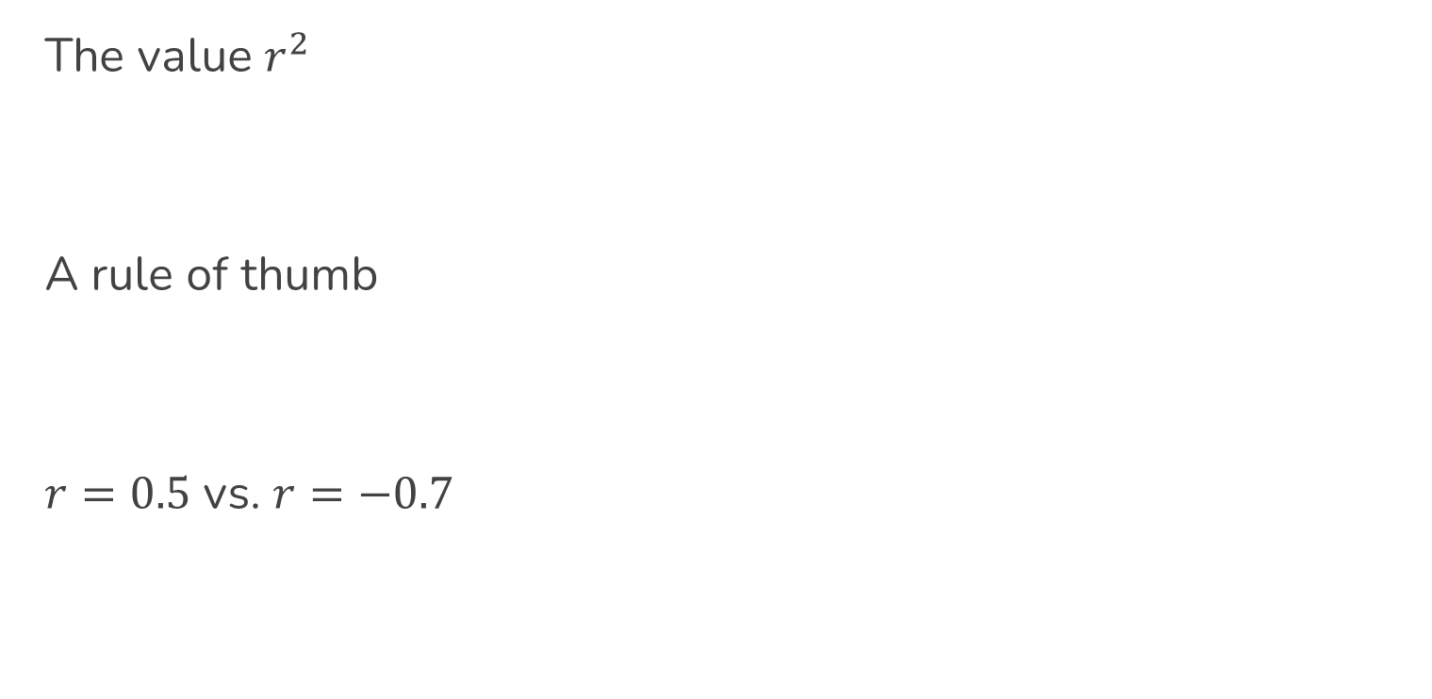
Correlation and Regression
The value $r^{2}$
A rule of thumb
$r=0.5$ vs. $r=−0.7$

Slide 12
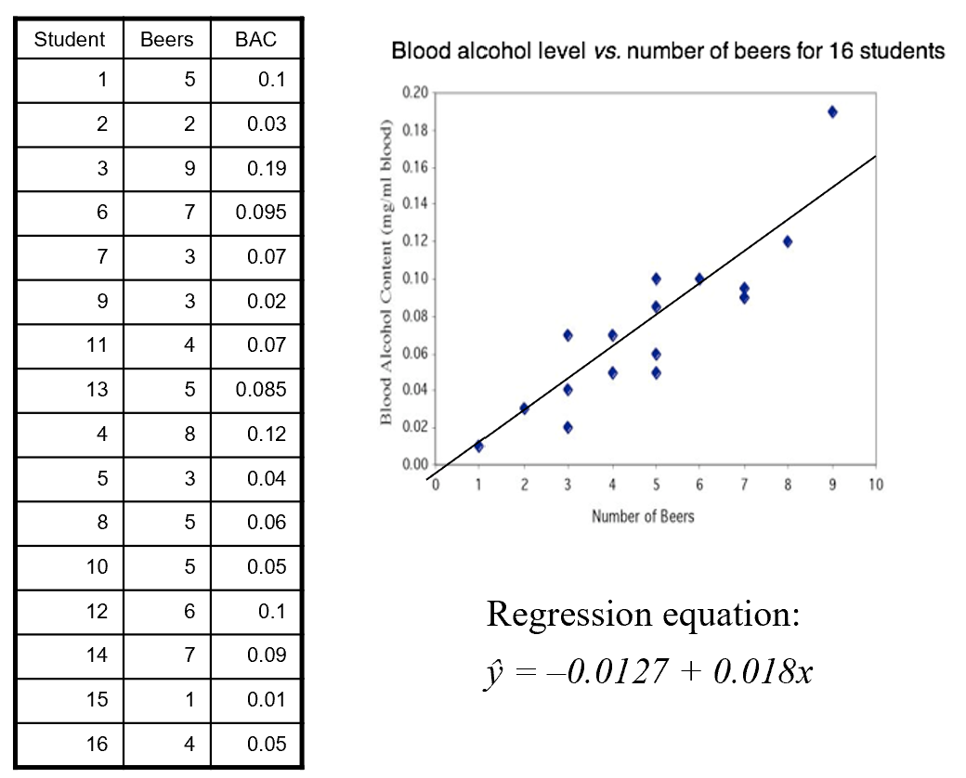
Prediction Limitations
Extrapolation
vs.
Interpolation

Slide 13
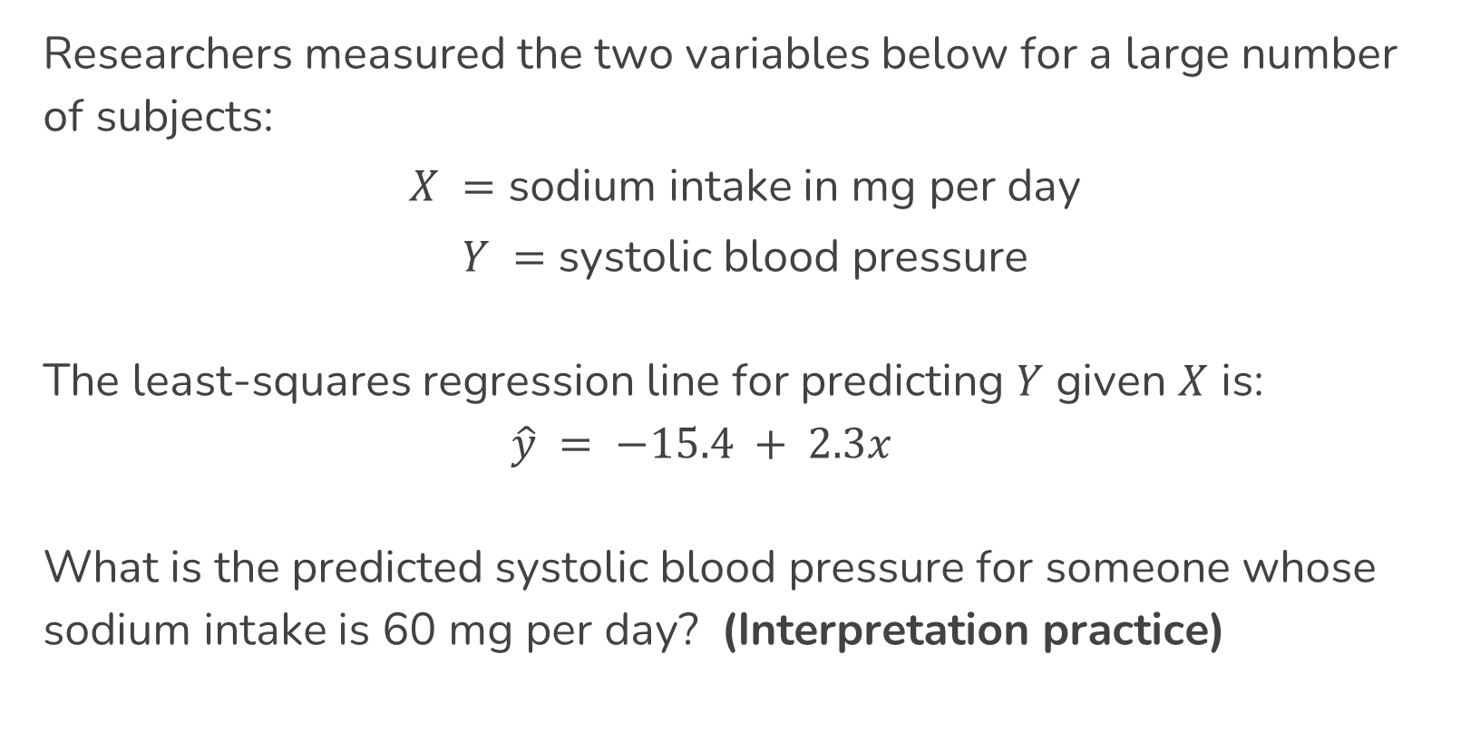
Let’s Practice! Sodium and Blood Pressure
Researchers measured the two variables below for a large number of subjects:
$X =$ sodium intake in mg per day
$Y =$ systolic blood pressure
The least-squares regression line for predicting $Y$ given $X$ is:
$$\hat{y} = −15.4 + 2.3x$$
What is the predicted systolic blood pressure for someone whose sodium intake is 60 mg per day? (Interpretation practice)

Slide 14
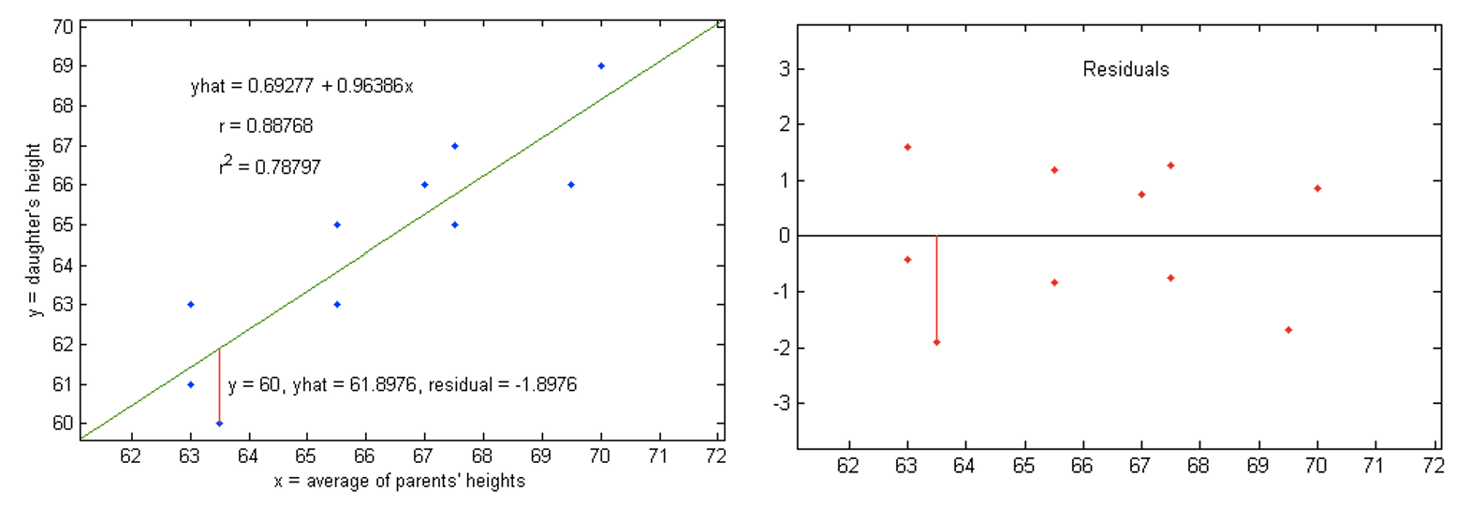
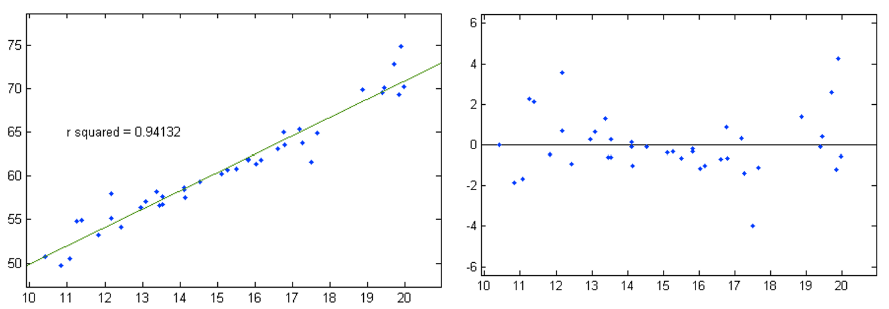
Residual Plots

Slide 15
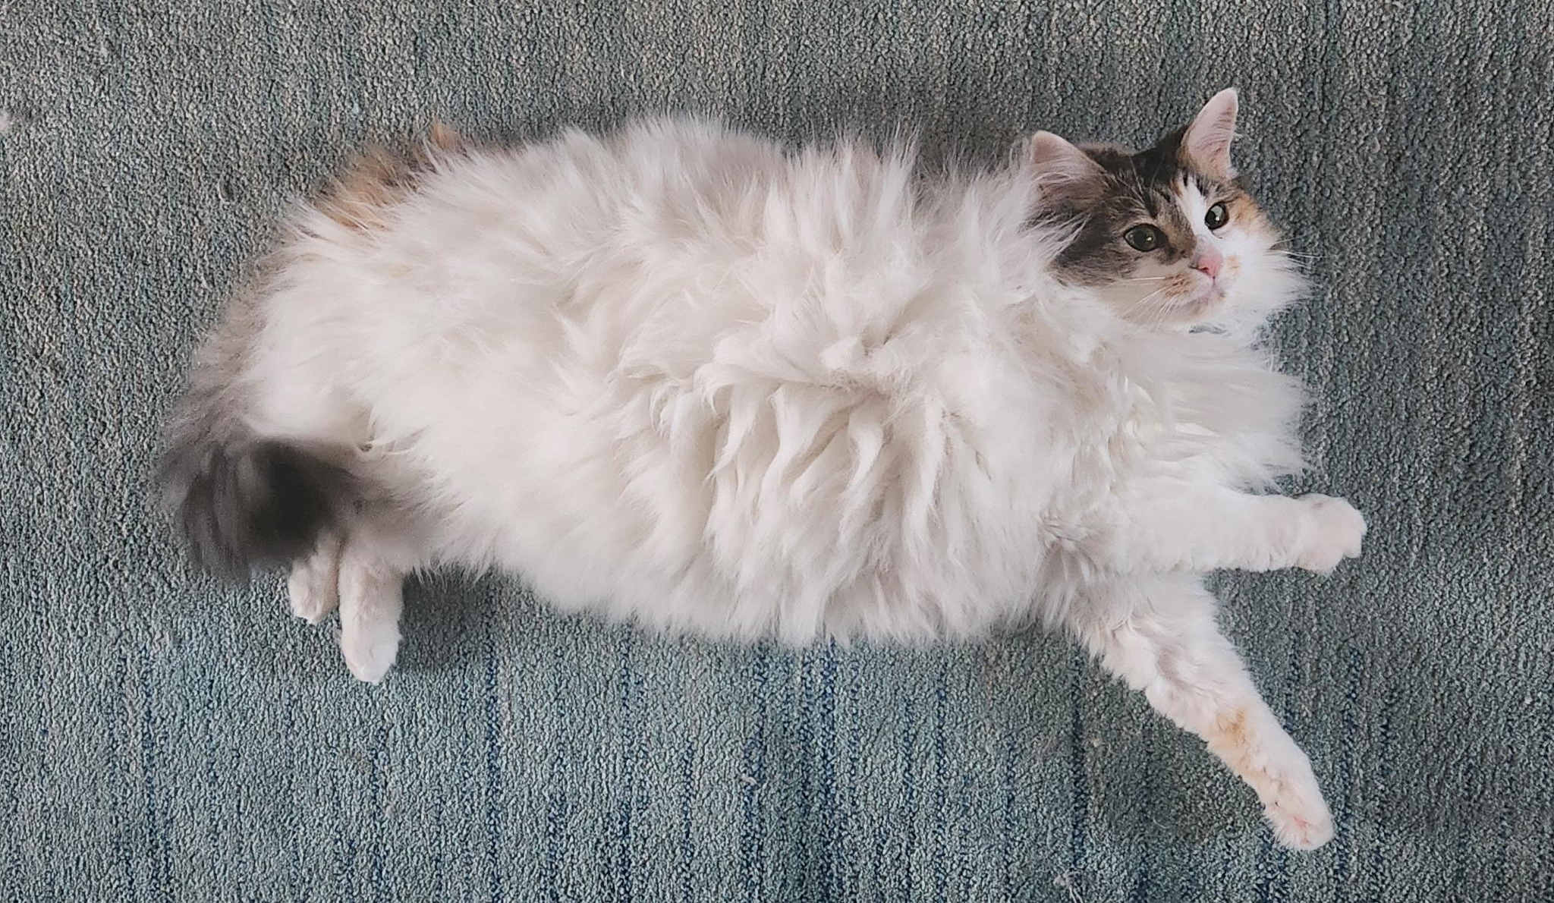
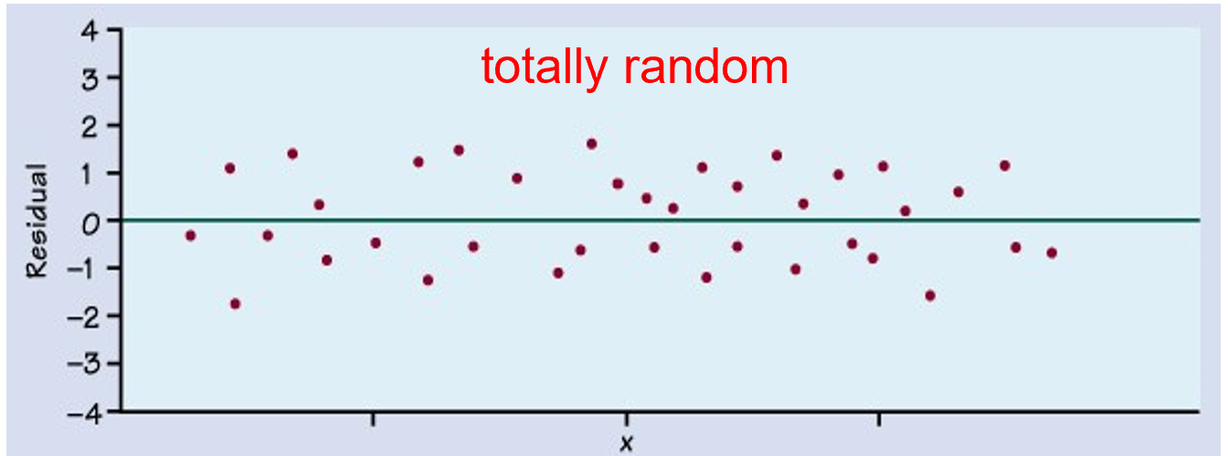
Residual Plots
“Ideal” style of residual plot:

Slide 16

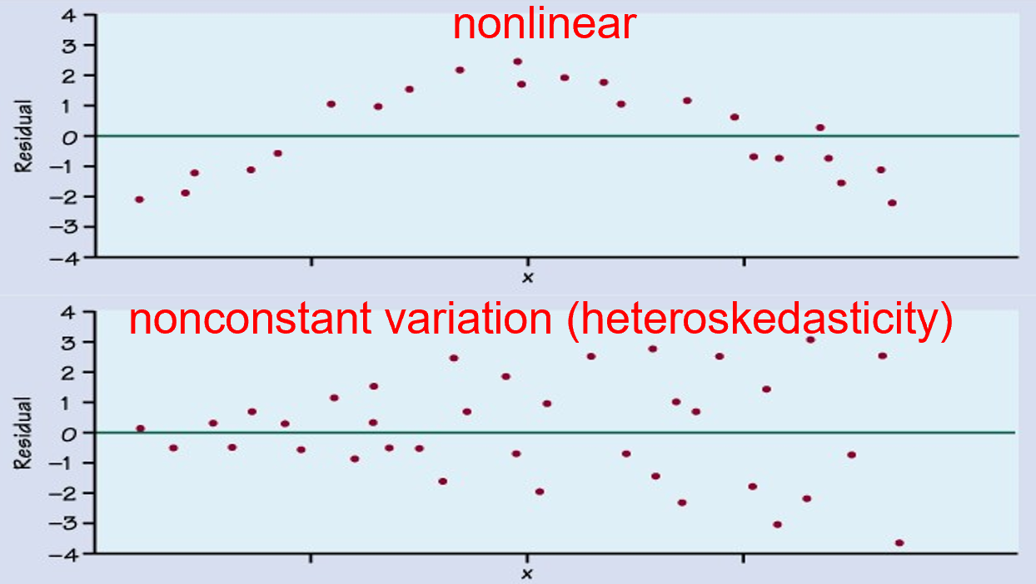
Residual Plots
Not-so-ideal residual plots:

Slide 17
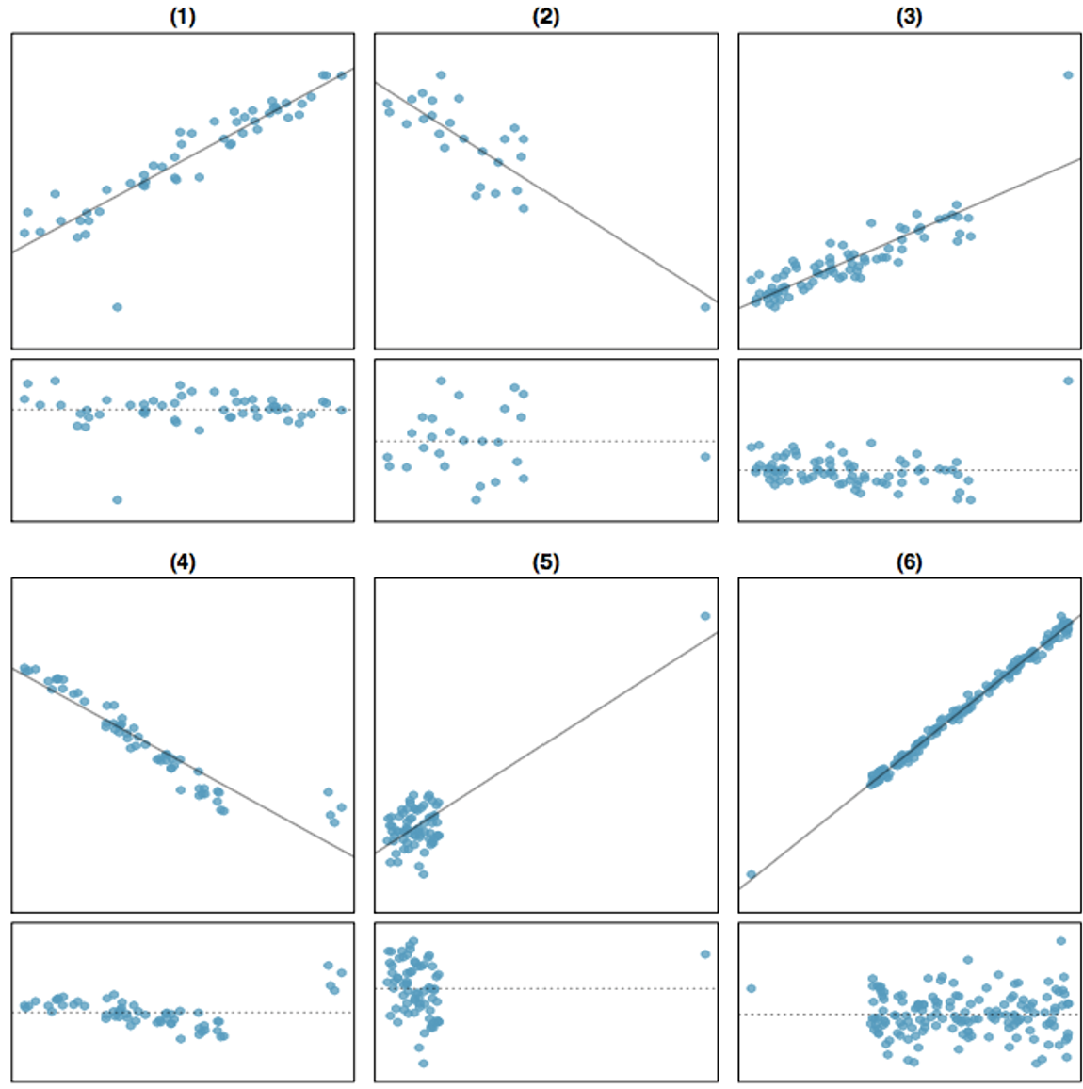
Outliers and Residual Plots

Slide 18
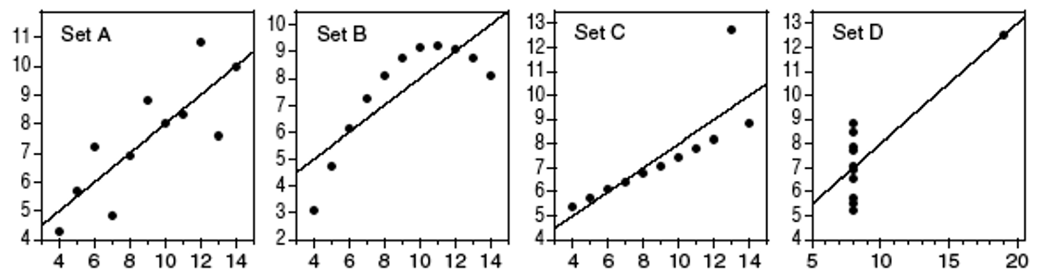
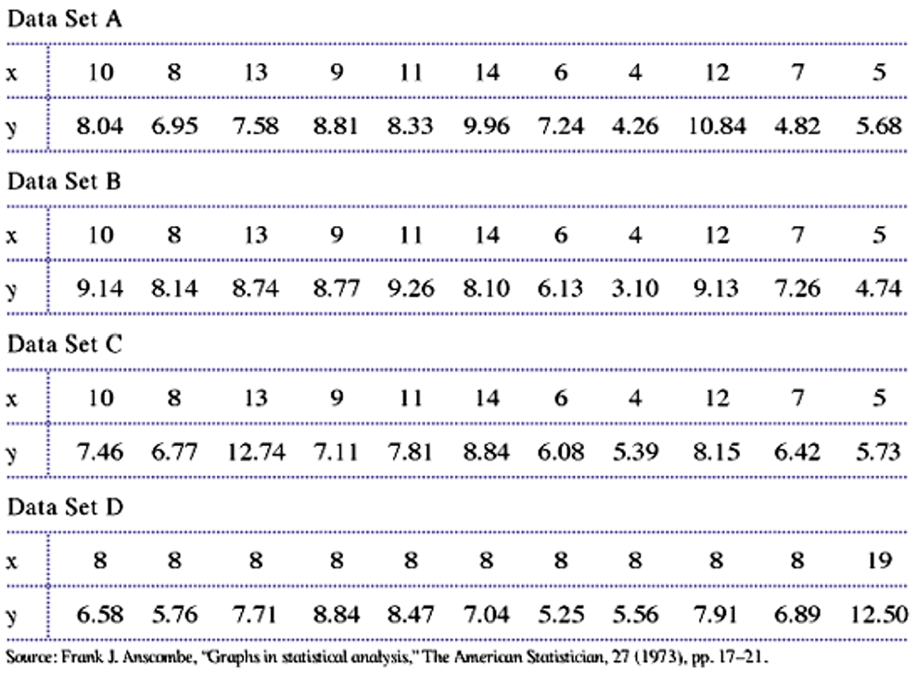
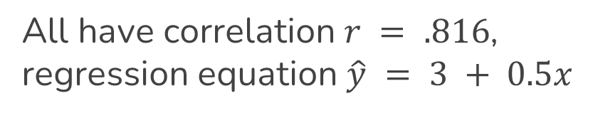
Importance of Plotting Data
All have correlation $r = .816$, regression equation $\hat{y} = 3 + 0.5x$

